Slide 1
Empowering others to use data
Jeff Leek
@jtleek
www.jtleek.com

Slide 2
Data science training
Internal talks
Internal training sessions

Slide 3
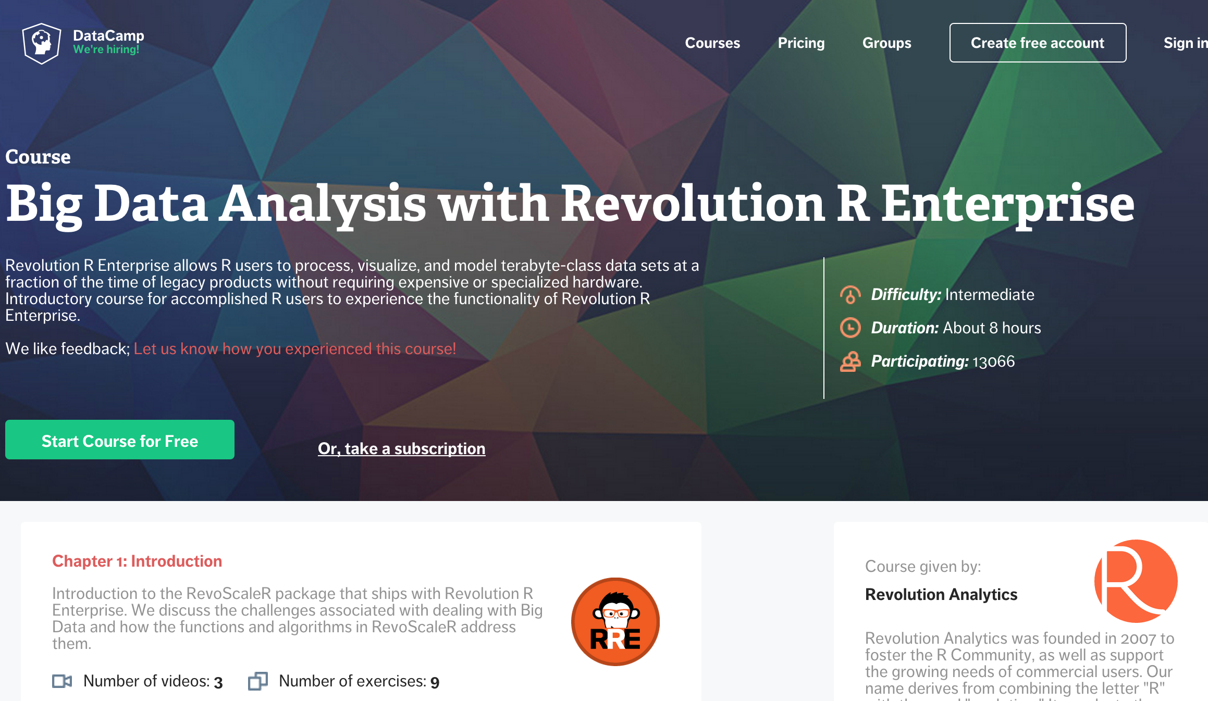
https://www.datacamp.com/courses/big-data-revolution-r-enterprise-tutorial

Slide 4
Interactive documents
Data apps
Interactive visualizations

Slide 5
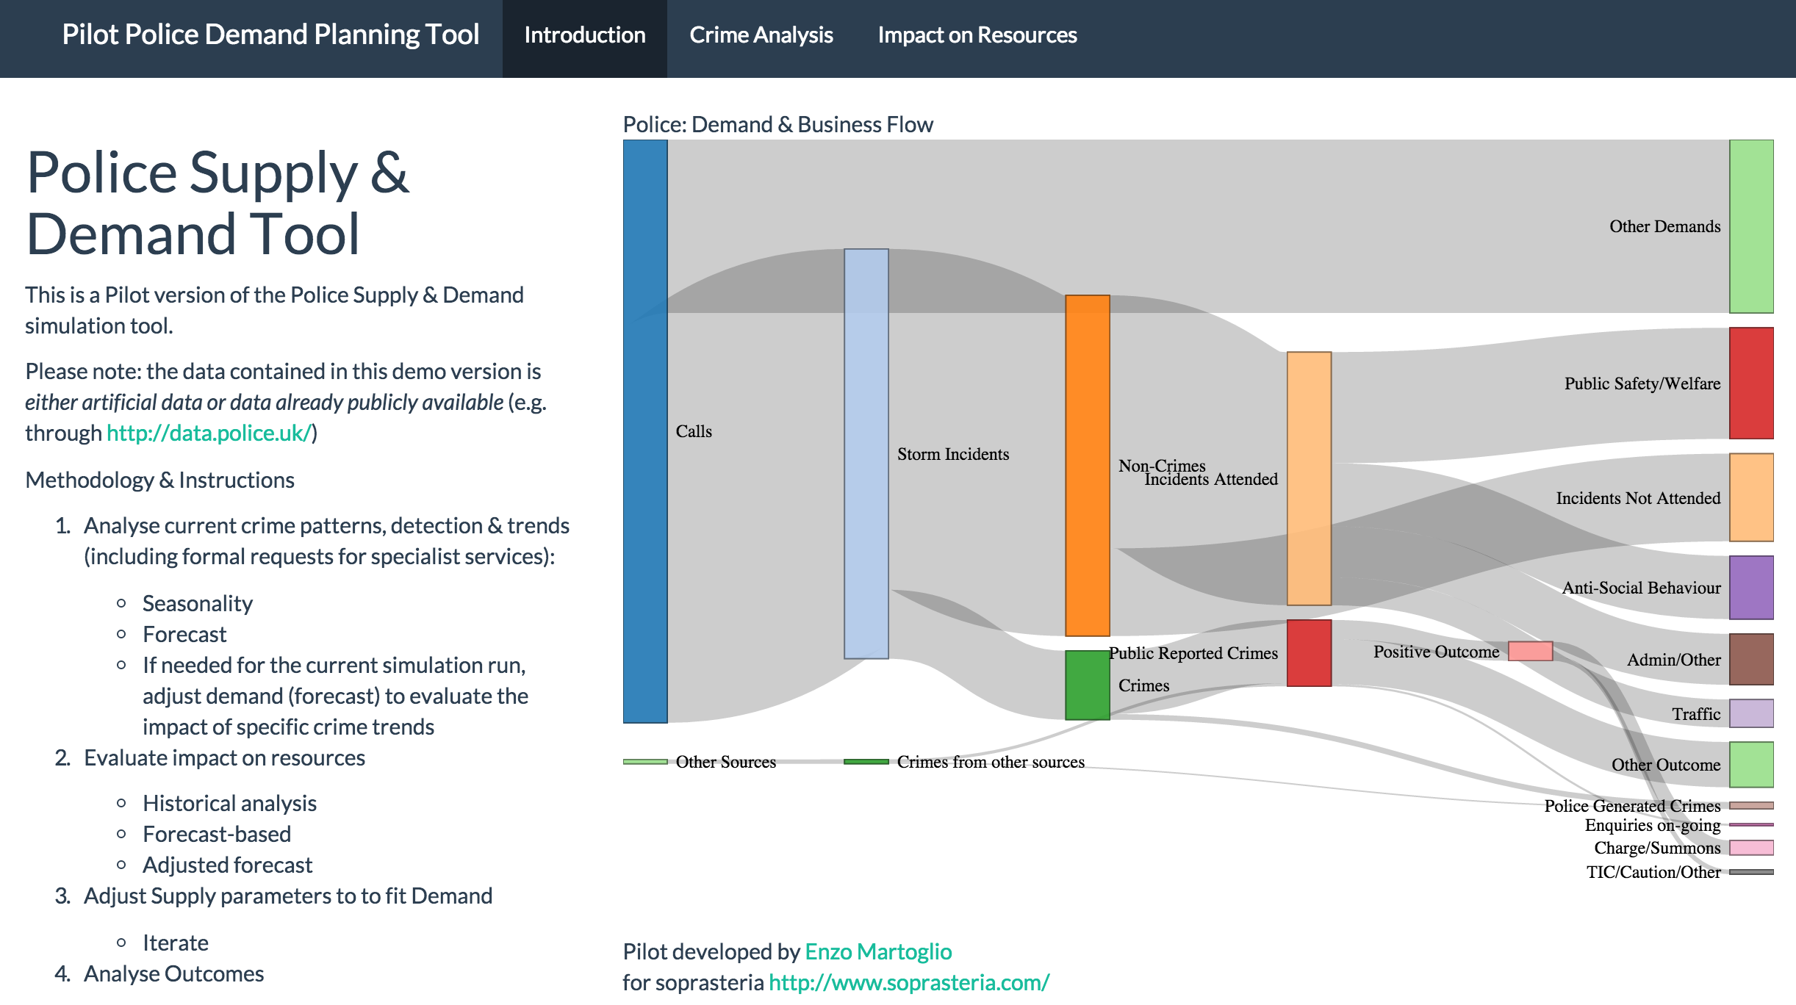
http://shiny.rstudio.com/gallery/

Slide 6
Data idea evaluation
Data science is hard
Peer review from data team & you

Slide 7
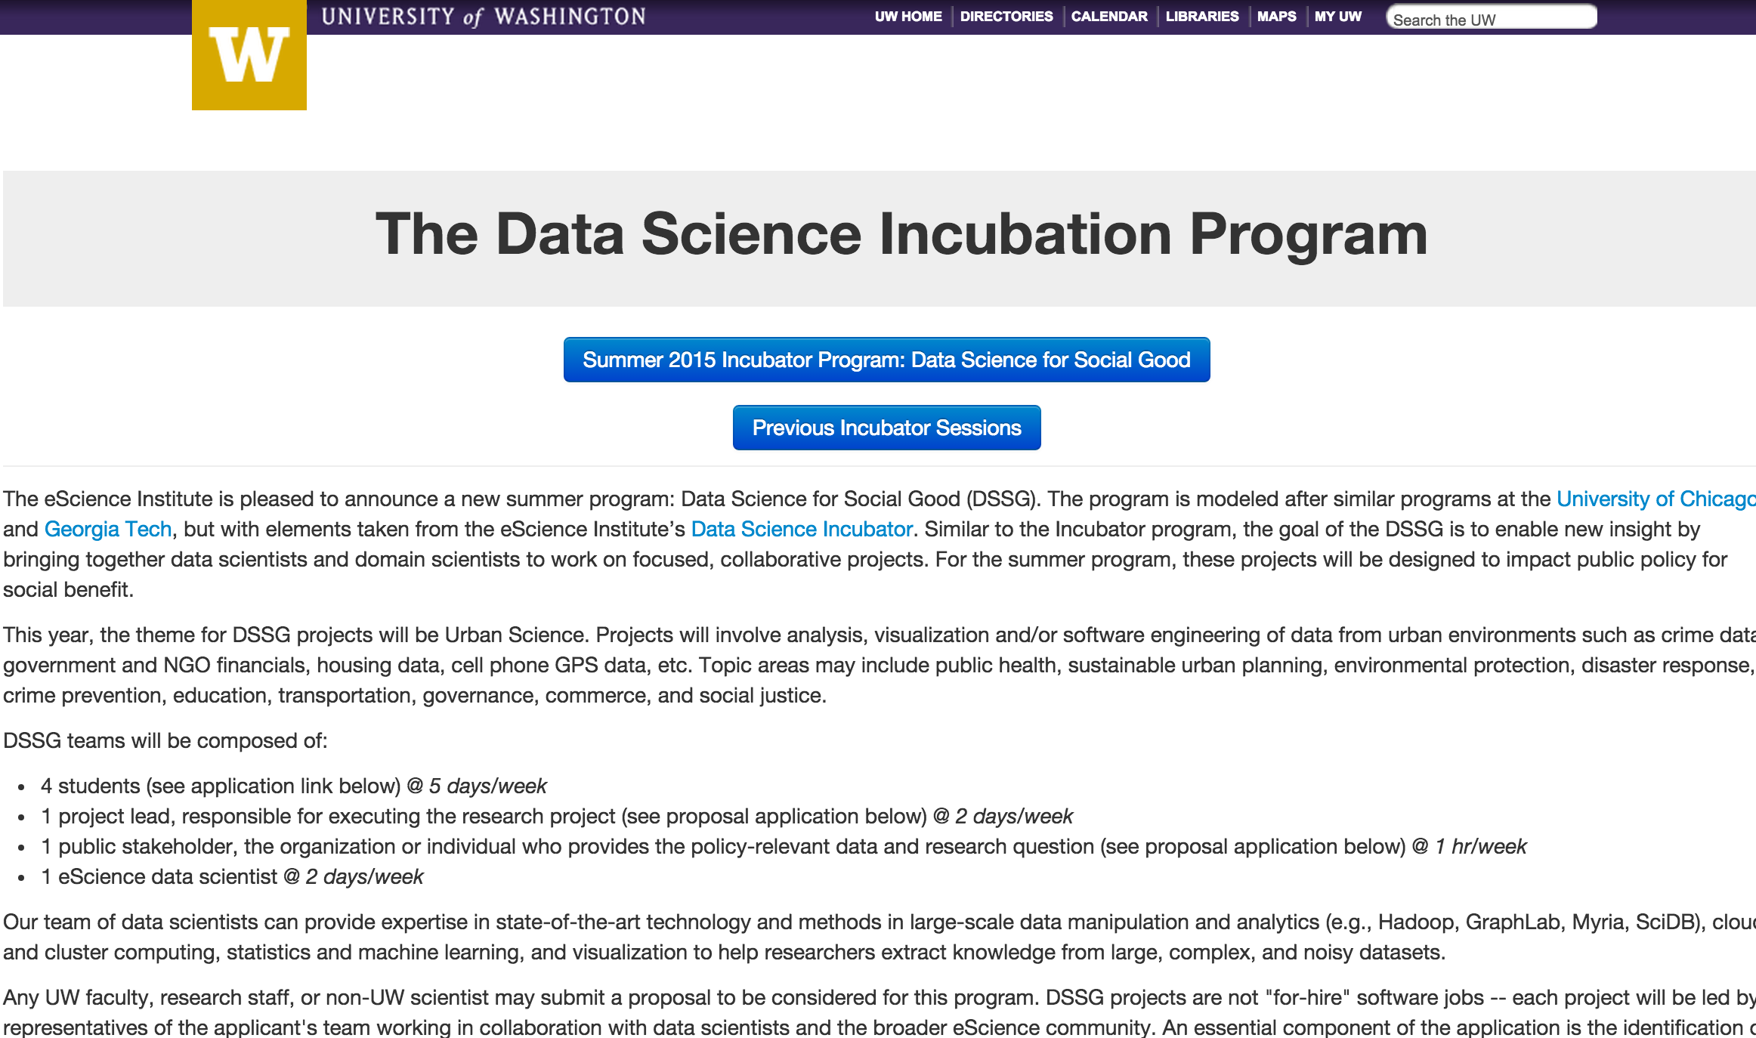
http://data.washington.edu/incubator/

